Slide 1


SEICHE 2023 Intermediate Arduino Programming for IoT
Instructor: Paul Frommeyer
www.paulfrommeyer.com
Corporate Sponsor: DXC Technology

Slide 2
REMINDER YOU MUST HAVE A WORKING LED MATRIX DISPLAY TO TAKE THIS CLASS! If displays are lost or damaged, replacements are $70 with 1-week lead time for replacement

Slide 3
Lesson Plan Overview
Lesson 1: 7Feb23 – Review, Addressing, and Pointers
Overview of lesson plan
Class Exercise: Validation of sketch uploading
Class Exercise: Validation of binary create and upload
More on the Preprocessor
Memory Organization and Variables
Review of addressing and pointers
Using pointers to variables
Declaring pointers in function calls
Call-by-value Function Calls
Call-by-reference Function Calls
Lesson 2: 14Feb23 – More Gory Details
Class Exercise: Call-by-reference variables
Introduction to Complex Data Structures
Using complex data structures
Storage declarations and Arduino
Lesson 3: 21Feb23 – Fonts Redux
MD_Parola library font usage review
The MD_Parola font format
Designing your own fonts
Declaring your own fonts
Using your own fonts with MD_Parola
Lesson 4: 28Feb23 – Intro to Visual Studio Code
Introduction to VSC
https://code.visualstudio.com/docs/introvideos/overview
VSCode Installation
VSCode Integration with Arduino and ESP8266
Lesson 5: 7Mar23 – Filesystems
Introduction to mass storage filesystems
The SD FAT, FAT16, and FAT32 filesystems
The exFAT filesystem
Introduction to SPIFFS
Class Exercise: Using SPIFFS
Lesson 6: 21Mar23 – WiFi
Review of WiFi technology (but no gory details)
Class Exercise: Review of WiFi access with WiFi Manager
Web server and client HTTP architecture
Introduction to HTML
Creating a basic ESP8266 web server
Lesson 7: 28Mar23 – Web Technology
HTML Forms
Processing form input with Arduino
Class Exercise: Display messages from a web page
Lesson 8: 4Apr23 – Internet Access
Obtaining weather information from the Internet
Class Exercise: Displaying weather information
Lesson 9: 11Apr23 – IoT Messaging and MQTT
Introduction to IoT network messaging and MQTT
Subscribing to an MQTT service
Publishing to an MQTT service
Class Exercise: Using MQTT and WiFi
Lesson 10:18Apr23 – Version control and Git
The need for document version control
The Git version control system
Installing Git
Using Git
Introduction to Github
Using Github
Class Exercise: Signing up for a Github account

Slide 4

Flash Drive Contents Reminder
When I update parts of your flash drives, you can either recopy the entire section, or just copy the updated part.
However, you will need to explicitly copy any new files so that they are locally accessible on your laptops
Copying just lesson files will– wait for it!– copy only the lesson files.
Make certain you have copied everything in RED! You should already have previously copied everything else!
FLASH DRIVE
IntermediateProgramming-Software
Archive–BasicProgrammingWith Arduino-Fall2022
Archive-IntroductionToArduino-Spring2022
IntermediateProgramming-Software
IntermediateProgramming-Lessons
IntermediateProgramming-Documentation
ESP8266FS-0.5.0.zip
IntermediateProgramming-Lessons
IntermediateProgramming-Documentation
IntermediateProgramming-Lesson1
IntermediateProgramming-Lesson2
IntermediateProgramming-Lesson3
IntermediateProgramming-Lesson6
ArduinoReference
Beginning C for Arduino, 2nd Edition
BoardsGuides
D1 Mini Reference
ElectronicsReference
IoT Reference
LED Matrix Display Architecture
HackSpace Magazine
Can’t do reading homework without the files!

Slide 5
Lesson 6 – Web Servers, Browsers, and HTML
Part A
WiFi Network Review
WiFi Operation
Joining a WiFi network
Getting an IP address
Class Exercise: ESP8266 WiFi redux
Basic web operation
HTML markup
Bare bones web page structure
Class Exercise: Creating a web page

Slide 6
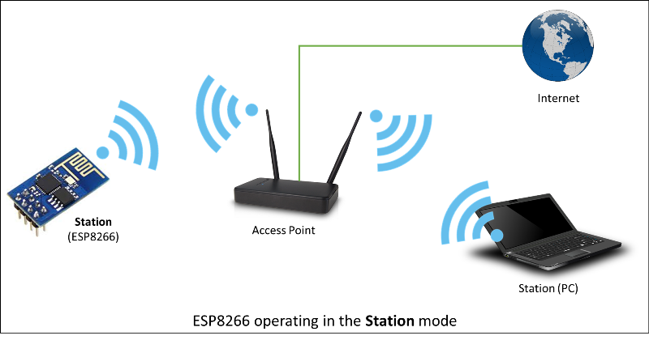
Wireless Network Review
Recall that in most cases you will be connecting to an existing access point
In this situation, each device that connects to an AP is called a client
Typically, the AP is then uplinked to the Internet
The ESP8266 mode for acting as a client is called, counterintuitively, station mode
AP – Access Point
SSID – Service Set Identifier; the name of a wireless network
IP Address – a unique 32 or 64 bit number assigned to each device connecting to a network (regardless of wired or wireless)
DHCP – Dynamic Host Configuration Protocol – The means by which a network hands out IP addresses to devices
Host – Catch-all term for a device connected to a network

Slide 7
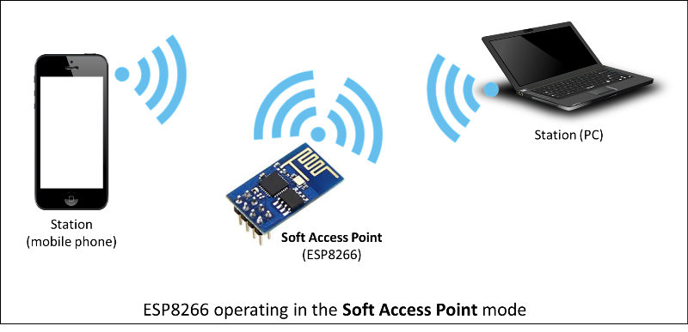
Wireless Network Review
An ESP8266 can act as a soft access point
In this mode, the ESP8266 itself provides WiFi connectivity for clients; it acts just like an AP
It’s called “soft” because it’s programmable

Slide 8
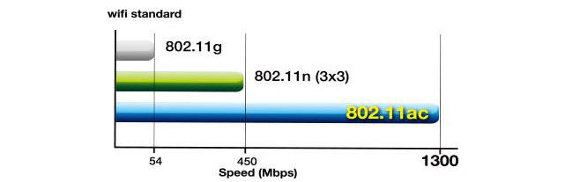
Wireless Network Types
There are different types of wireless, mostly differentiated by speed and range
Nearly all Ethernet based wireless networks support multiple speeds simultaneously for backwards compatibility

Slide 9
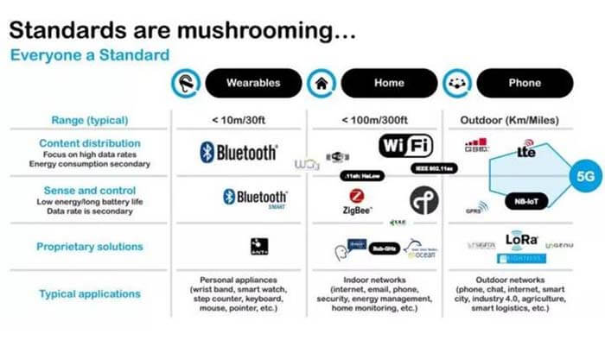
Wireless Network Types (cont)
There are many other types of wireless network
For this class, we are concerned only with Ethernet based wireless, common known as “WiFi”

Slide 10

A Note On WiFi
WiFi is an industry trademark of the Wireless Alliance; it has a formal logo
WiFi has no technical meaning, and is only a marketing term designed to replace technical naming with a simple, consumer-friendly moniker
And the plan worked!

Slide 11
WiFi Multi
ESP8266WiFiMulti.h can be used to connect to a WiFi network with strongest WiFi signal (RSSI). This requires configuring one or more access points with SSID and password. It automatically switches to another WiFi network when the WiFi connection is lost.
Having multiple SSID’s configured allows the ESP8266 to easily be moved between different networks

Slide 12
Classroom Exercise - WiFi
And here is our class sketch for WiFi. Go ahead and load and run!
SKETCH6A – WiFi Setup Excerpt
// Setup for wifiMulti
ESP8266WiFiMulti wifiMulti;
// WiFi connect timeout per AP. Increase when connecting takes longer.
const uint32_t connectTimeoutMs = 5000;
char ipaddrbuffer[20];
void setup(){
Serial.begin(9600);
// Don't save WiFi configuration in flash - optional
WiFi.persistent(false);
Serial.println("\nESP8266 Initializing Multi WiFi\n");
// Set WiFi to station mode
WiFi.mode(WIFI_STA);
// Register multi WiFi networks
wifiMulti.addAP("CFC_Public", "");
wifiMulti.addAP("PALAS", “xxxxxx");
// wifiMulti.addAP("ssid_from_AP_3", "your_password_for_AP_3");
if (wifiMulti.run(connectTimeoutMs) == WL_CONNECTED)
{
Serial.println("WiFi connected!");
Serial.print("WiFi SSID: ");
Serial.println(WiFi.SSID());
sprintf(ipaddrbuffer,"%s",WiFi.localIP().toString().c_str());
Serial.print("WiFi IP Address - ipaddrbuffer: ");
Serial.println(ipaddrbuffer);
}
else
{
Serial.println("WiFi not connected!");
}
Serial.println("\n\n");
}

Slide 13
ESP8266 WiFi
We are now using WiFiMulti, which allows us to specify multiple SSID’s (wireless networks) that our displays will try to connect to; whichever has the strongest signal will win. This means we can take our display different places and it will still work (as long as we know the network credentials in advance) ESP8266WiFiMulti wifiMulti;
This is how we set WiFi for “connect to an existing station”: WiFi.mode(WIFI_STA);
The while() loop will keep looping as long as WiFi.status() is other than WL_CONNECTED. The loop will exit only if the status changes to WL_CONNECTED.
Once the ESP8266 connects, we print out the SSID that it ended up using: Serial.print("WiFi SSID: "); Serial.println(WiFi.SSID());
When we connect to a webserver, we need to know it’s IP address. This statement prints to the Serial Monitor the IP address assigned to our ESP8266 by the WiFi network: Serial.println(WiFi.localIP());

Slide 14
ESP8266 WiFi (cont.)
If we want to show the IP address on our dot matrix displays, more steps are involved. This is because the IPaddress data type is in actuality a complex, multifarious C++ class– a class which Serial.Println() knows how to handle, but MD_Parola does not.
So we have to convert the Ipaddress data structure into an array of char– a string– which MD_Parola will accept
The incantation for this conversion is: char ipaddrbuffer[20]; sprintf(ipaddrbuffer,"%s",WiFi.localIP().toString().c_str());
Once we have the IP address as a string in ipaddrbuffer, we can display it with MD_Parola: if(pmx.displayAnimate()) { pmx.displayText(ipaddrbuffer,PA_CENTER,50,0,PA_SCROLL_LEFT,PA_SCROLL_LEFT); yield(); }

Slide 15
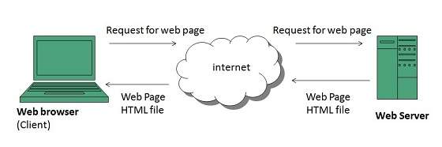
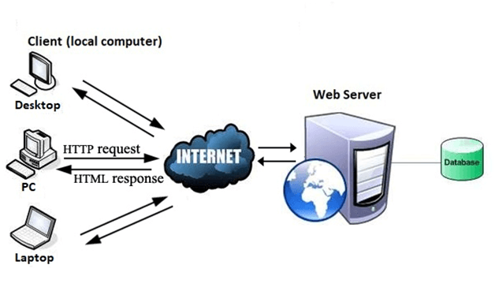
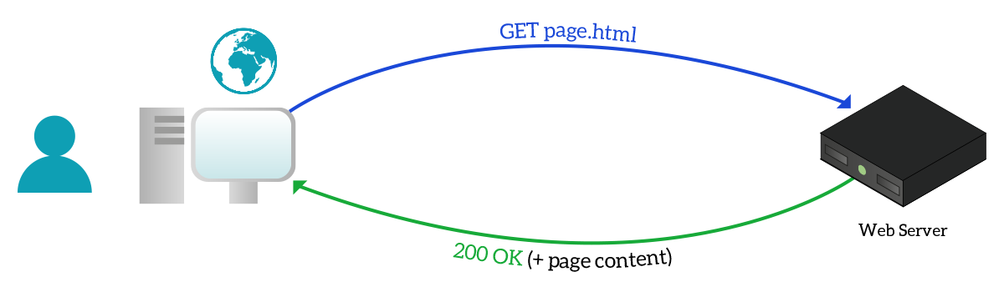
Basic Web Operation
The World Wide Web (WWW), runs on a network protocol called Hypertext Transfer Protocol (HTTP)
HTTP describes how clients, which are requestors, can obtain content from servers, which are content providers
Thus, HTTP uses a client-server communication model

Slide 16
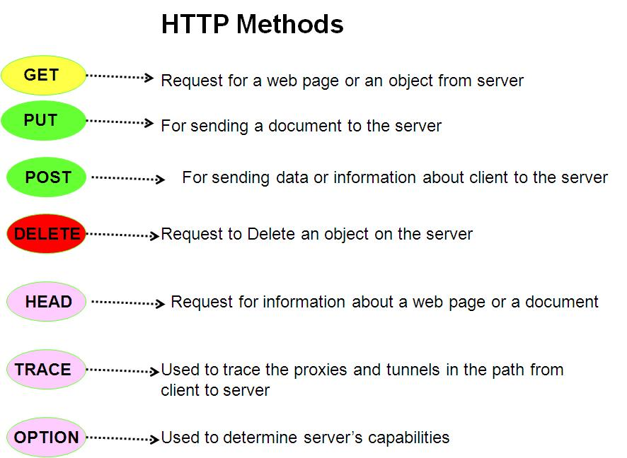
HTTP Operation
HTTP has several modes which clients and servers use to exchange data
Which mode is used has to be mutually agreed upon (negotiated)
Certain modes are designed for this negotiation

Slide 17
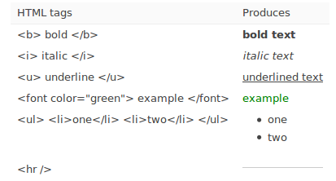
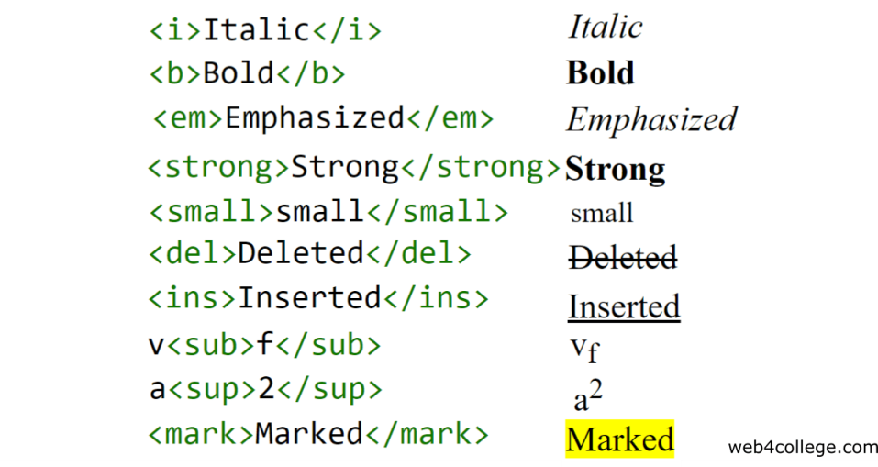
HyperText Markup Language - HTML
There is a specific document format that must be used by all webservers and clients, called HTML
HTML is a formal markup language– a metagrammar and container notation that is used to “wrap” other content in “tags”
Using tags to delineate different types of content gives the web servers and clients a very limited lexical understanding of that content
VERY basic HTML markup

Slide 18
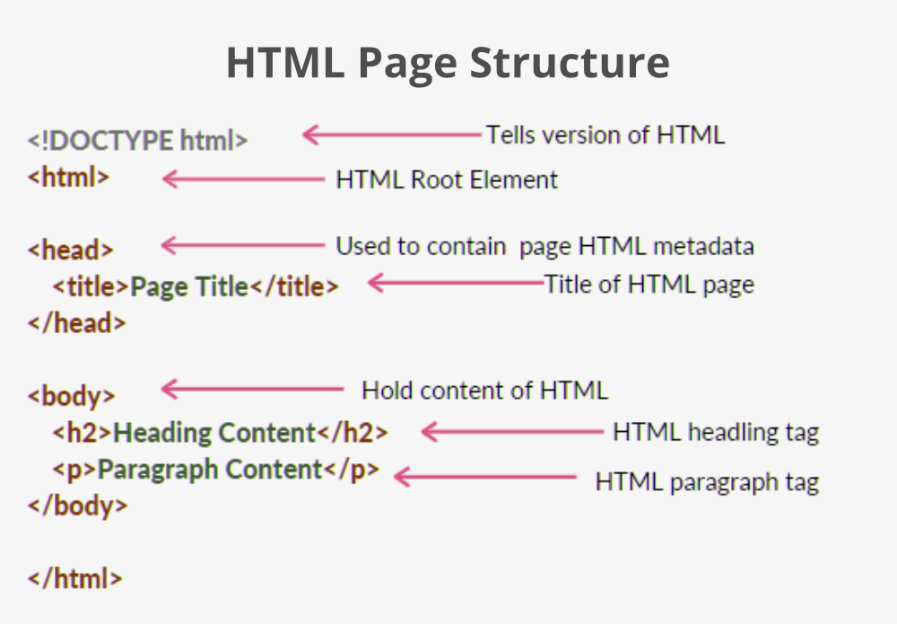
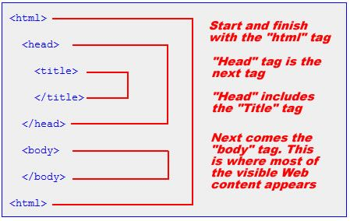
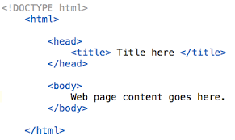
Web Page Structure
HTML web pages use a very formal structure
This structure is hierarchical
The elements of the hierarchy are nested, some inside others

Slide 19

Bare Bones Web Page Structure
<html>
<head>
</head>
<body>
</body>
</html>
Absolute minimum; no content
Just a title; title displays differently in different browsers
<html>
<head>
<title>SEICHE Website</title>
</head>
<body>
</body>
</html>
<html>
<head>
<title>SEICHE Website</title>
</head>
<body>
<h1>Welcome to our web page!</h1>
</body>
</html>
Both a title and a header

Slide 20
CLASS EXERCISE
Using either VS Code, Kate (Linux), or Notepad (Windows), create a new web page, seiche4.html, in your class directory. [Hint: You can just open seiche3.html and then Save As ☺]
Add body text to your new web page, then open it in Firefox (or the browser of your choice)
Using the formatting tags show in previous slides, modify the web page you just created to change the style of the various sections
Remember to reload the page to see your edits!

Slide 21
Formal End of Lesson 5
HOMEWORK
No Homework This Week
In next week’s exciting episode
Review of WiFi technology (but no gory details)
Class Exercise: Review of WiFi access with WiFi Manager
Uploading a web page using SPIFFS
Class Exercise: Create a basic web server

Slide 22
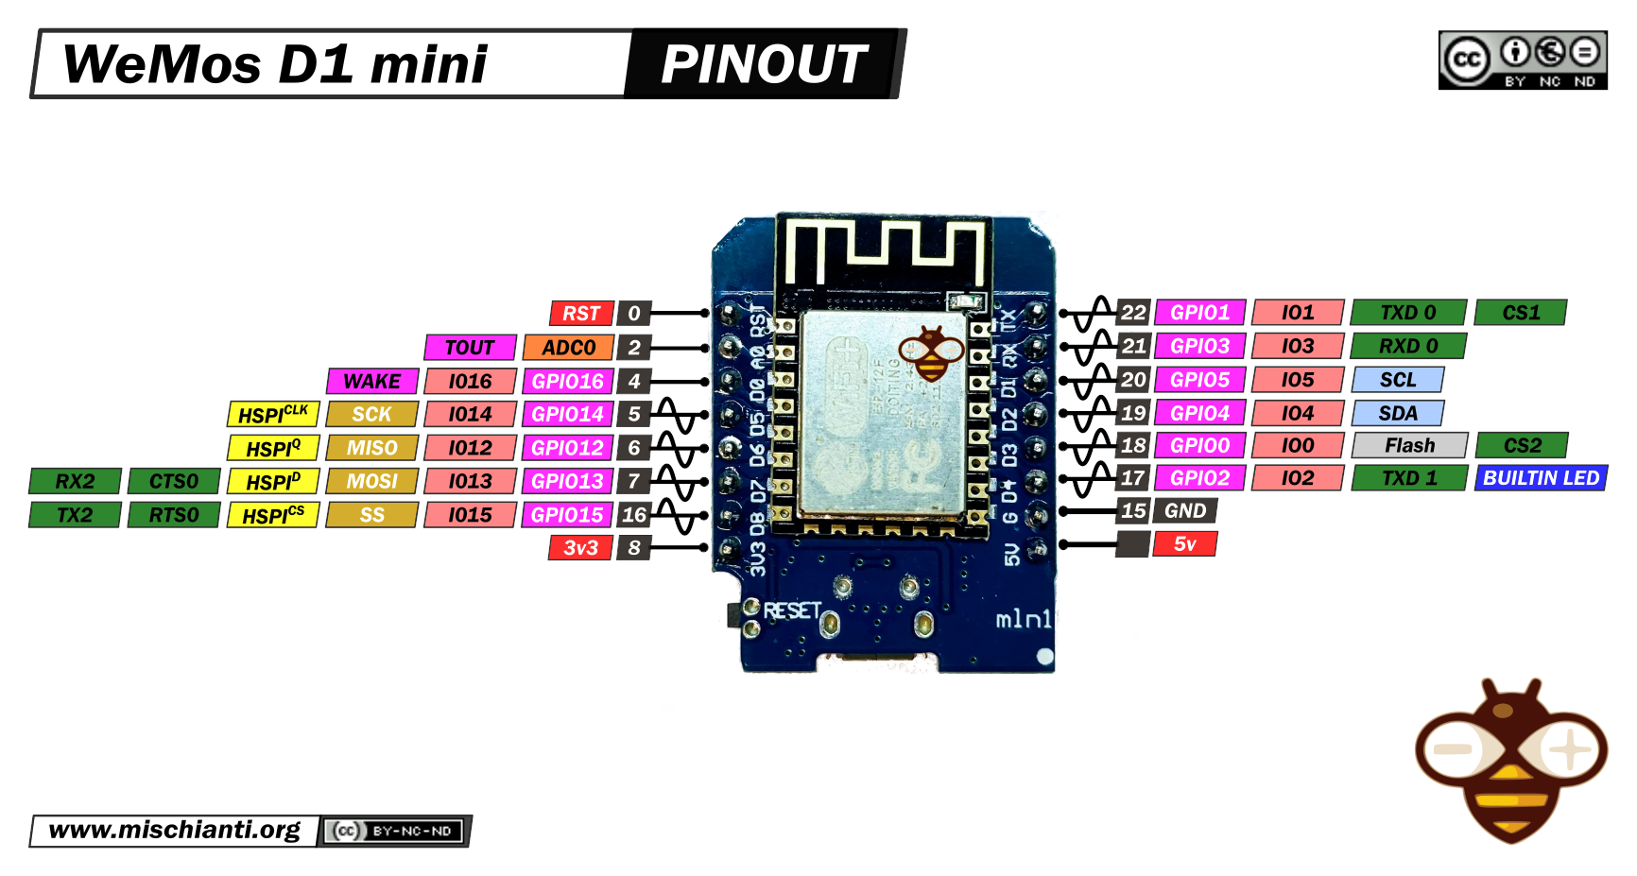
Our Microcontroller: The WeMos D1 Mini
Hilights
11 digital IO: all are interrupt and pwm capable (except D0/GPIO16)
1 analog input (3.2V max input): A0/ADC0
Micro USB or Type-C USB Port (clones usually have micro USB)
Two SPI interfaces (one is used for on-board flash memory), one I2C interface, two serial ports
Built-in WiFi (client or standalone access point modes) and Bluetooth
Compatible with MicroPython, Arduino, NodeMCU
Uses the CH340 USB-to-serial driver (installation usually needed on Windows)
Extremely low cost (approx $3.00 US on Amazon; one of the two least expensive components in your kits)

Slide 23
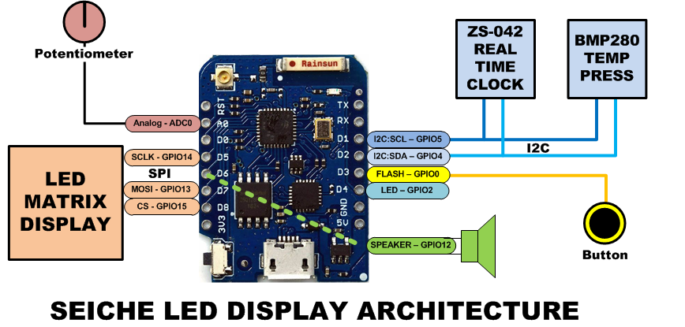
SEICHE LED Display Architecture
Red MAX7219 8x32 LED matrix display (SPI)
ZS-042 real-time clock module (I2C)
BMP280 Temperature and Pressure Sensor (I2C)
Piezoelectric speaker (PWM)
10KΩ Potentiometer (Analog-to-Digital Converter)
Button (Pullup and interrupt)

Slide 24
sprintf() Function Syntax
sprintf()’s formal syntax is: sprintf(char *buffer, const char *format, variable list)
buffer is an array of type char (the parameter when passed can also be a pointer [address] for such an array) which will contain the formatted output of the function
format is an unmodifiable (constant) array of char containing the format descriptors for all variables subsequently passed to the function, which is to say, it’s the format string.
The variable list are just the comma separated variables that are to be formatted
All variables passed in a single call to sprintf() are combined into a single output string
sprintf() automagically puts a terminating NULL (\0) at the end of the ASCII output

Slide 25
sprintf() Format Strings
sprintf() format strings contain conversion specifiers that specify how each individual variable is to be converted
sprintf() conversion specifiers have the following general syntax (all begin with a percent-sign):
%[flags][minimum field width][.][precision][length][conversion character]
% - special token that indicates the start of a conversion specifier
Flags – these modify the behavior of the specification
Minumum field width – as it says on the tin; this the minimum number of characters to be converted
. – The period is a separator between field width and precision
Precision – means one of the following depending on the variable type and conversion specifier
The maximum number of characters to be generated from a string
The number of digits after the decimal point for type float conversions (e, E, or f)
The zero-filled minimum number of digits for an integer
Conversion character – A single character which determines the output type of the conversion specifier; a single character that specifies the type of output format for the corresponding data or variable

Slide 26
sprintf() Conversion Specifiers
Below are the general conversion specifiers and what they do.
Specifier | What it does
d, i | int - integer; signed decimal notation
o | int – unsigned octal (no leading zero)
x, X | int – unsigned hexadecimal, no leading 0x
u | int – unsigned decimal
c | int – single character, after conversion to unsigned char
s | char * - characters from string are printed until \0 (NULL) or precision is reached
f | double – decimal notation of form [-]mmm.ddd where number of decimals is specified by precision; precision of zero (0) suppresses the decimals altogether
e, E | double - exp notation; default precision of 6, 0 suppresses
g, G | double – Use %f for <10^4 or %e for >10^4
p | void * - print output as a pointer, platform dependent
n | Number of characters generated so far; goes into output
% | No conversion, put a % percent sign in the output

Slide 27
sprintf() Conversion Specifiers
Below are the flags and what they do.
Flag | What it does
- | Left justification
+ | Always print number with a sign
spc (space) | Prefix a space if first character is not a sign
0 (zero) | Zero fill left for numeric conversions
# | Alternate output form depending on conversion character o – first digit will be zero x or X – 0x or 0X (respectively) prefixed to non-zero results e, E, f, g and G – Output will always have a decimal point g and G – trailing zeroes will never be removed

